Slide 1


L3: UMD OFFICE OF SUSTAINABILITY -
GREEN TERP PROGRAM
TEAM IC24056: JAMES DAWSON, AIDAN POWERS, AREEBA QURESHI, DUNYASHA S M YATTOGODA

Slide 2

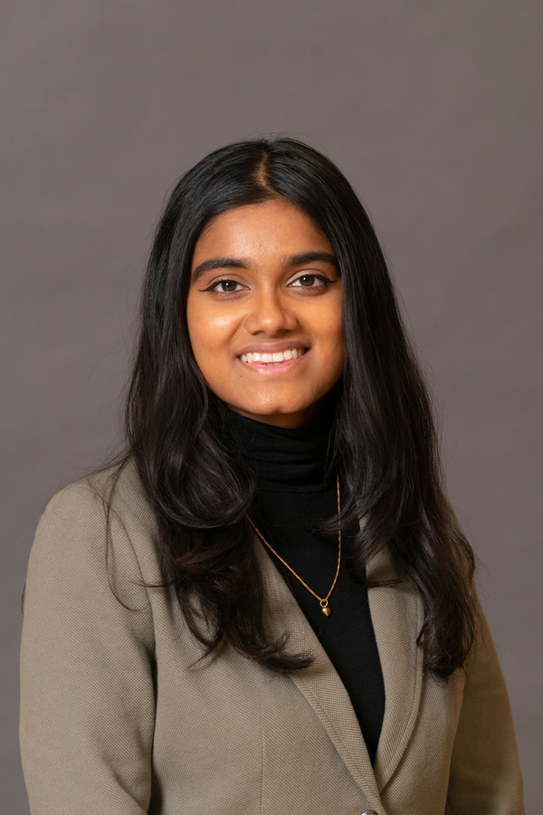
MEET OUR TEAM
James Dawson
Aidan Powers
Areeba Qureshi
Dunyasha S M Yattogoda
Masters of Finance, B.S. Management & Operations Management/Business Analytics
Operations Management and Business Analytics Senior
Operations Management and Business Analytics Senior
Operations Management and Business Analytics Senior

Slide 3

PROGRAM OVERVIEW
The Green Terp Program is a dynamic initiative that is dedicated to cultivating a sense of environmental responsibility among students, with one approach being through encouraging pledges of commitment. To optimize the effectiveness of these initiatives, our team analyzed data in order to identify the most impactful variables enhancing engagement and productivity.
Speaker: Areeba

Slide 4
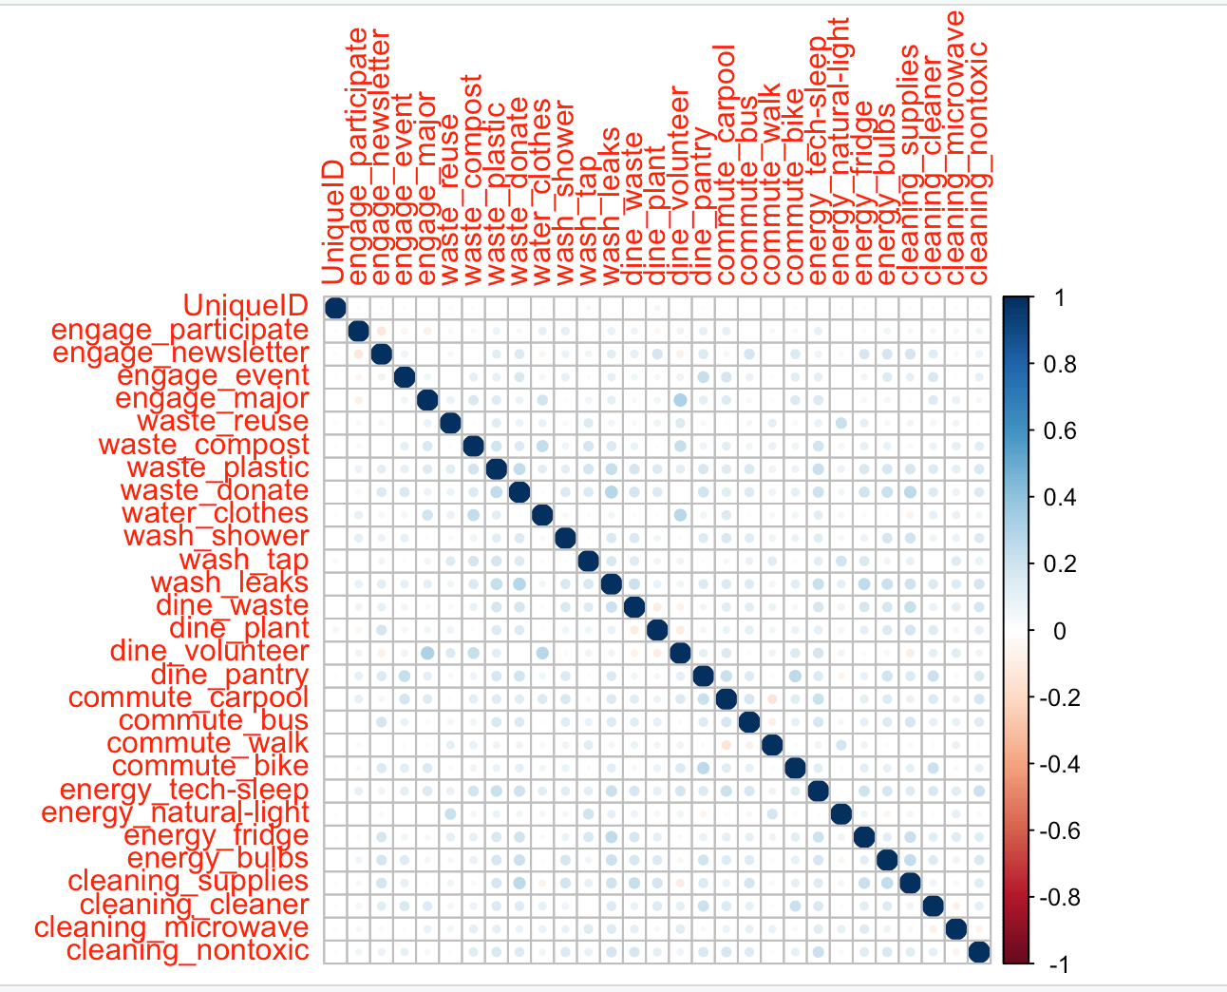
CORRELATION MATRIX
Speaker: Aidan

Slide 5
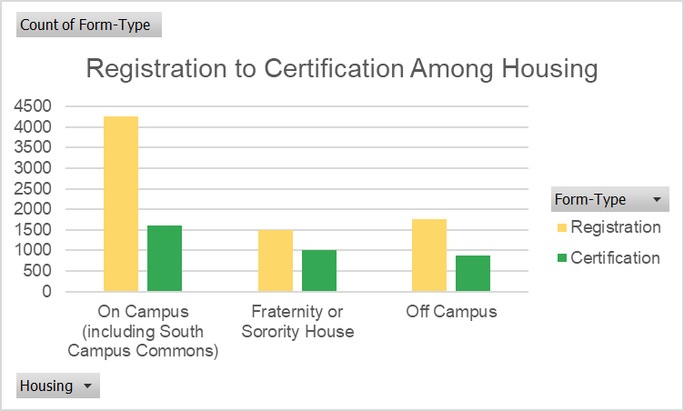
CONVERSION PATTERNS VS. HOUSING
Speaker: Aidan

Slide 6
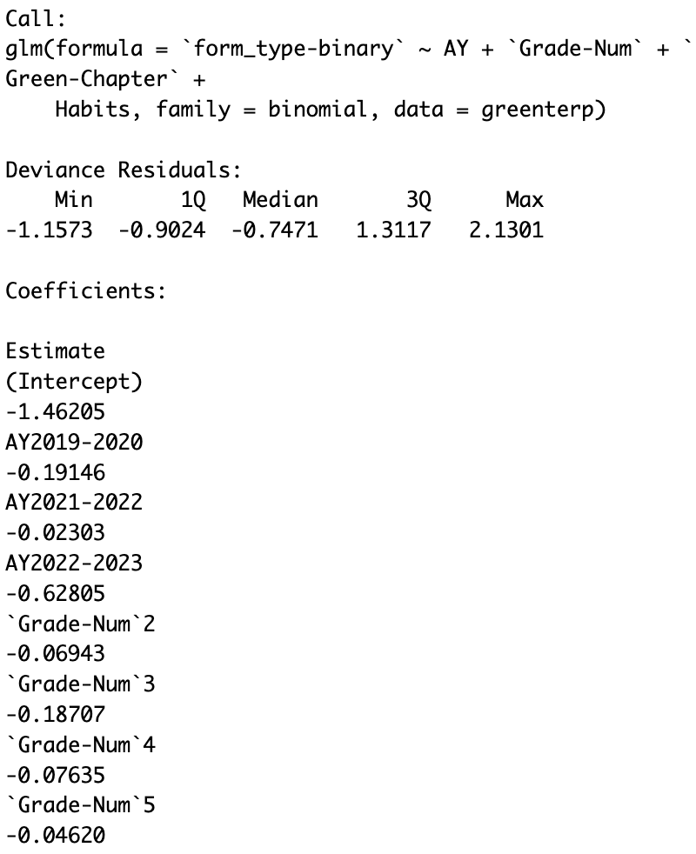
LOGISTIC REGRESSION:
FACTOR ANALYSIS
Factor analysis was conducted as a starting point
Dummy variable was created to compare against as a baseline
Insights such as:
Those with Green Chapter certification were 58% more likely to convert than those who did not.
Speaker: Dunyasha

Slide 7
TERP HABITS: FROM REGISTRATION TO CERTIFICATION
Baseline: “I don't really take environmental action.”
Those who responded “I take environmental or sustainable actions when it's convenient for me” were 39% more likely to stick with the challenge
“I orient my life around environmental and sustainable choices” was 77% more likely to convert
“I go out of my way, and may spend time or money to be sustainable" was 82% more likely to certify.
Speaker: Dunyasha

Slide 8
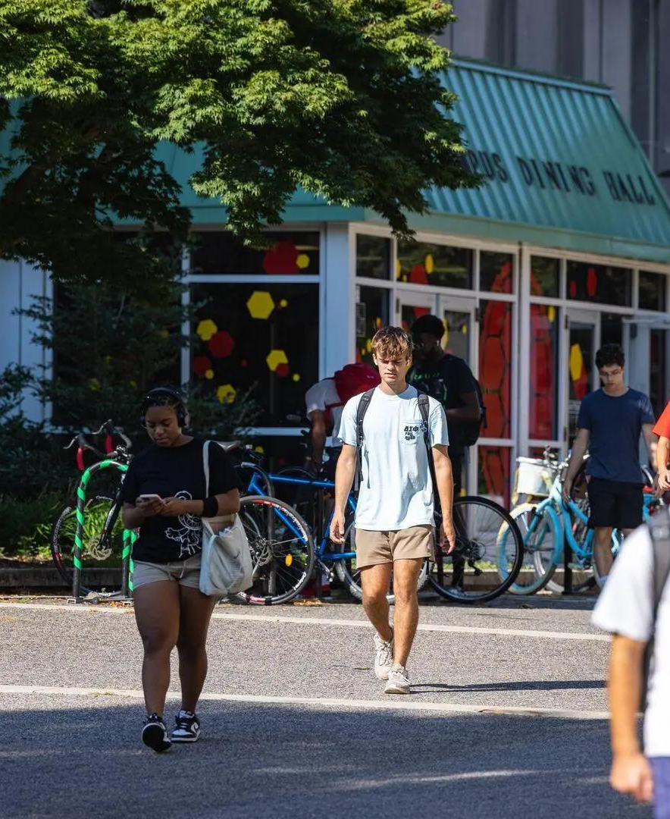
LOGISTIC REGRESSION:
FRESHMEN ARE A KEY DEMOGRAPHIC
Freshmen convert:
7%
7.5%
more than Sophomores
more than Seniors
18%
4%
more than Juniors
more than Grad Students
Speaker: Dunyasha

Slide 9
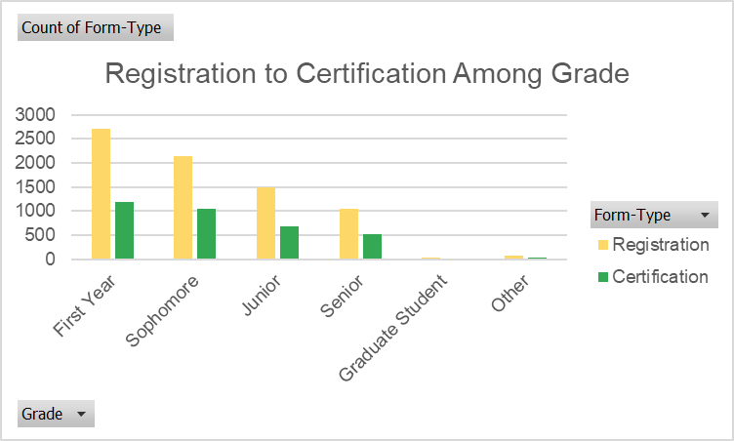
Speaker: Dunyasha
Notes:
As Terps get older, they become less likely to certify after registering.

Slide 10
CONVERSION RATE FROM REGISTRATION TO CERTIFICATION
The conversion rate was 46.5%
46.5% of students successfully completed the certification process after initially registering for it
Speaker: Dunyasha

Slide 11
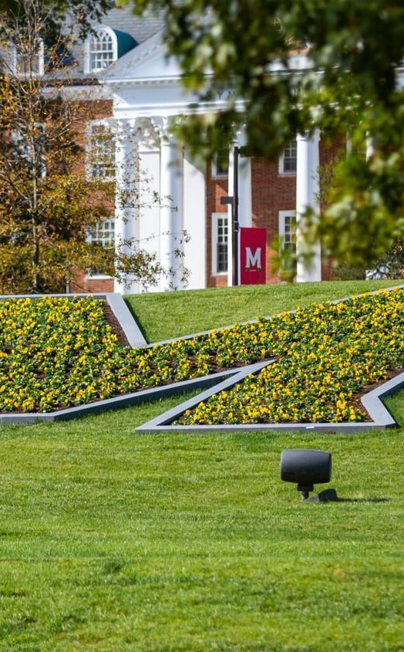
CONSIDERATIONS FROM
DATA COLLECTION
2 methods for categorizing sustainability pledges and corresponding results
From 2018-2021, 7 broad categories were used for both registration and certification
After 2021, 7 broad Categories (registration) vs 7 Categories with 4 subsets (certification)
Comparing broad sustainable categories to more specific counterparts presents various issues
Speaker: James

Slide 12

EXAMPLE 7 SIMPLE CATEGORIES METHOD: “DID YOU CONSERVE ENERGY?”
In 2020's registration, 2115 out of 2236 pledged to conserve energy (95%) in 2020
910 out of 967 certified this behavior (94%)
In 2021, the 7 broad categories (for certification only) were modified by including 4 subcategories
Similarly, 95% of students pledged to conserve energy in 2021 (1960 of 2075 responses)
100% of respondants reported participation in this category (1,136 out of 1,136)
Speaker: James

Slide 13
EXAMPLE: 7 EXPANDED CATEGORIES
Rather than “Did you conserve energy?”, the question becomes:
“Did you set computers or printers to hybernate or sleep?...
OR...
“Did you turn off lights and/or use natural light?”
OR...
“Do you not have a minifridge OR use a fridge with EnergyStar rating?”
OR...
“Do you choose LED lightbulbs?”
Speaker: James

Slide 14
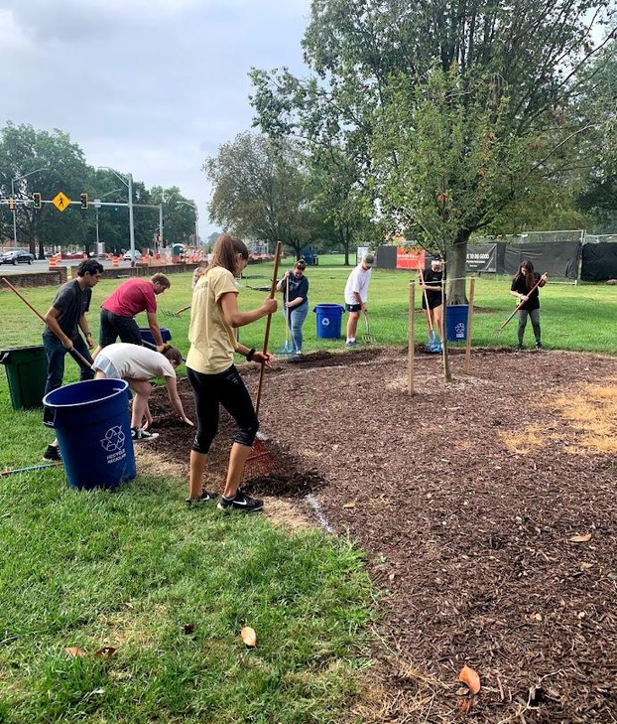
AN ANSWER “YES” TO ANY OF THESE RETURNS A RESULT OF REDUCING ENERGY USAGE.
Questions are broad and all encompassing
Of 8,638 responses with subcategories, 8,638 particpated In each major category (100%)
Students are interpreting each category differently during certification, and likely qualifying for new behaviors that they actually didn’t modify.
Attempts to standardize these different data methods would likely lead to models that are not accurate predictors of the program’s success.
Speaker: James

Slide 15

TEAM IC24056'S
RECOMMENDATIONS FOR ENHANCING GREEN TERP PROGRAM
LEARN MORE
Speaker: Aidan

Slide 16
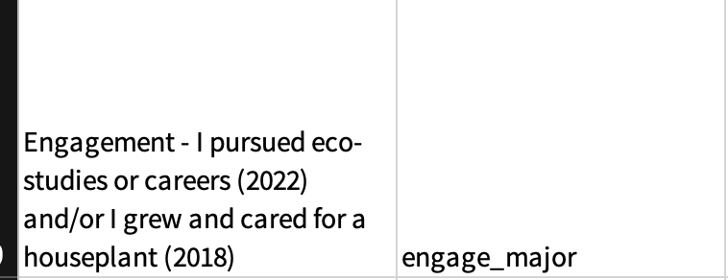
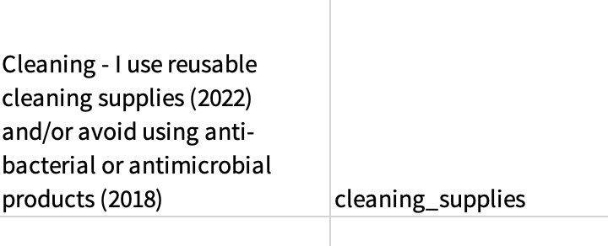
Recommendations
OFFICE OF SUSTAINABILITY SHOULD CREATE A DATA GOVERNANCE FRAMEWORK
Partner with Consultants/Data Science Students
Creating surveys that doesn’t skew is hard: large amounts of data is not advisable for actionable models
Potential resources are the College of Information Systems and local consulting firms
Consistency Is Key
Upon careful construction of data framework, Green Terp should stay consistent year to year; categories should be standardized year over year
Speaker: Aidan

Slide 17
SURVEY RESPONSES SHOULD BE NOT GROUPED
Partner with Consultants/Data Science Students
Changing definitions of variables year over year complicates accurate model creation.
Green Terp should collaborate with surveyors to develop a standardized, neutral survey aimed at measuring specific aspects.
Consideration of weighting practices based on their impact is essential for accurate analysis.
Presentation Design
Speaker: Aidan

Slide 18

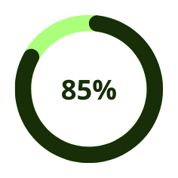
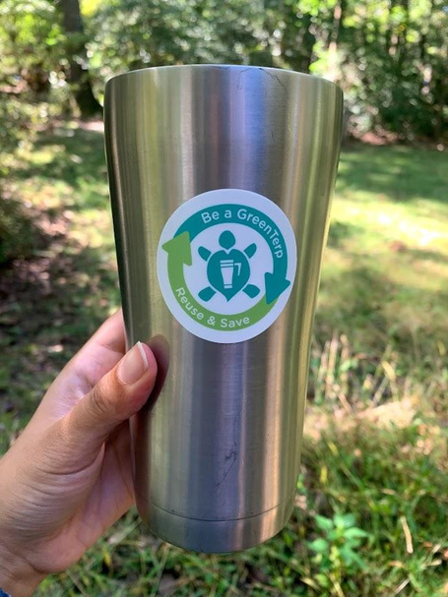
Recommendations
POTENTIAL NEW METRICS
Green Terp can utilize UMD’s network to monitor other indicators of success
Are recycling bins filling up faster after registration?
Monitoring attendance at sustanability events
Are parking lots more vacant after registration
Speaker: Aidan

Slide 19

THANK YOU

Slide 20
CASE STUDY: STUDENT #111001430
Upon registration, this student did NOT pledge to conserve water or dine sustainably.
After certification, this student DID report dining sustainably and conserving water
They washed In cold water, turned off taps while brushing, reported leaky faucets, ate at least one plant based meal per week, and ate less packaged food OR got take out less often
Did the student adopt new behavior, or simply realize they were already acting In a way that the survey considers “conserving water”?

